Slide 1
FOREST FIRE PREDICTION
BY
Team: White Devil
MOHAMED ASHIF ABDULLA J
RAVIKUMAR J
YATHUSUN R

Slide 2
Problem Statement
The proposed Forest Fire Prediction model is based sensor network incorporated to an alert system. The developmental approach of the proposed system includes two modules:
Forest Fire Identification : Identification of fire affected areas.
Forest Fire Management: Remedial measure for Forest Fire is all about detecting where the fire initiated in the forest.

Slide 3
Data Collection
Steps:
The dataset was created by manually separating into different forest fire classes. We had consulted the forest officers and had asked them to provide details about the forest and the previous fire accidents.
This dataset was used for Detection and Classification of Forest Fire. As part of the work, the following activities were carried out (1) How to extract various image features (2) which image processing operations can provide needed information (3) which image features can provide substantial input for classification. The survey work is available in IEEE conference paper.

Slide 4
METHEDOLOGY
A. Image acquisition
Fire affected forest image is captured through a clear camera. To find the exact fire affected, the RGB color of the cropped image is must be clearly
B. Image preprocessing
The basic idea of the procedure is to upgrade the picture information and enhance the image properties. Image pre-processing is basic for showing, putting away and transmission off picture. It brings about image improvement in forest fire picture using RGB shading
C. Image segmentation
convolutional network algorithm is used for noise reduction process of fire identification in forest. Using CNN provides the forest activist has an advantage of detecting fire sparks at early stages simply by exploring the complex features through camera. CNNs are adopted for fire identification in forest because of their highly automated feature learning techniques from the processed forest images.

Slide 5
METHEDOLOGY
D. Image classification
Several classification methodologies like Bayesian, artificial neural network [ANN], fuzzy classification. In the classification process, the forest fire Forest fire dataset is categorized into two sets, one to be training dataset and other the testing dataset. The training dataset is analyzed using deep CNN to extract its features and
Characteristics for comparison with the testing dataset. The testing dataset is a set of data whose features are to be analyzed and the forest is to be classified. The classifier performs analysis on the testing dataset and classifies based on the comparison with the training

Slide 6
METHEDOLOGY
D. Feature extraction
The paddy leaf disease consists of different lesion shape and lesion color because of several types of disease such as Nematode, Blast, Smut, and Spots. Features such as shape, color play a major role in disease identification. Shape can be identified by measuring the breadth and height of the paddy diseased image to measure the object pixel count.
E. Image classification
Several classification methodologies like Bayesian, artificial neural network [ANN], . The training dataset is analyzed using deep CNN to extract its features and haracteristics for comparison with the testing dataset.

Slide 7
Data Modelling:
Algorithm: Forest fire classification using deep CNN.
Input: Forest fire colored Forest fired images.
Output: Classified Forest fired images & Preventive Measures.
Step 1: Start.
Step 2: Train the 200 selected images with deep CNN and obtain the features for pattern matching.
Step 3: Select the colored image of a specific Forest fire from testing database.
Step 4: Crop multiple Forest fired spot from the image and choose the ideal one.
Step 5: Apply deep CNN algorithm for images denoising
Step 6: Apply color and texture feature extraction
Step 7: Train the color and texture feature with classifier
Step 8: Determine and classify the images using deep CNN
Step 9: Highlight the Forest fire affected and remedial measures
Step 10: Stop.

Slide 8
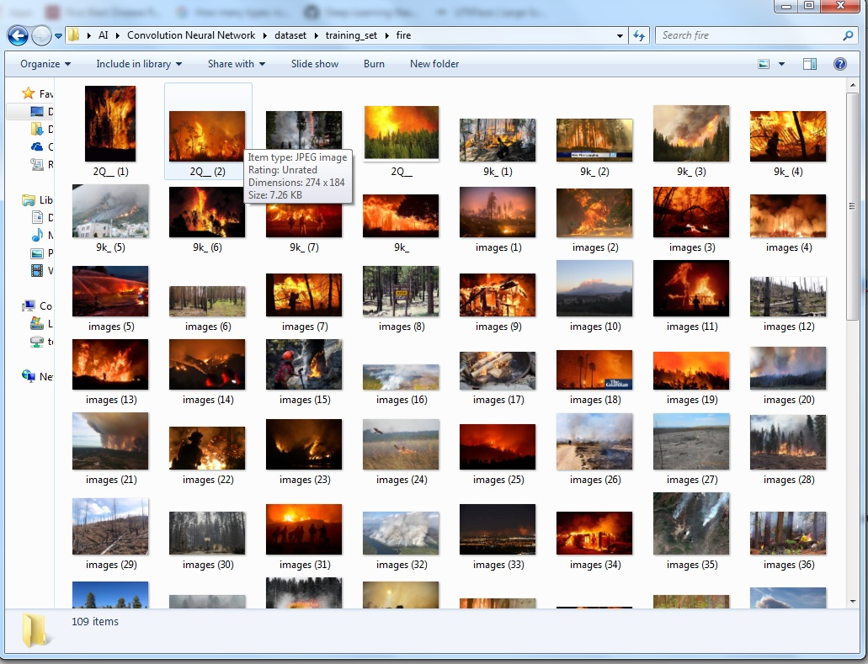
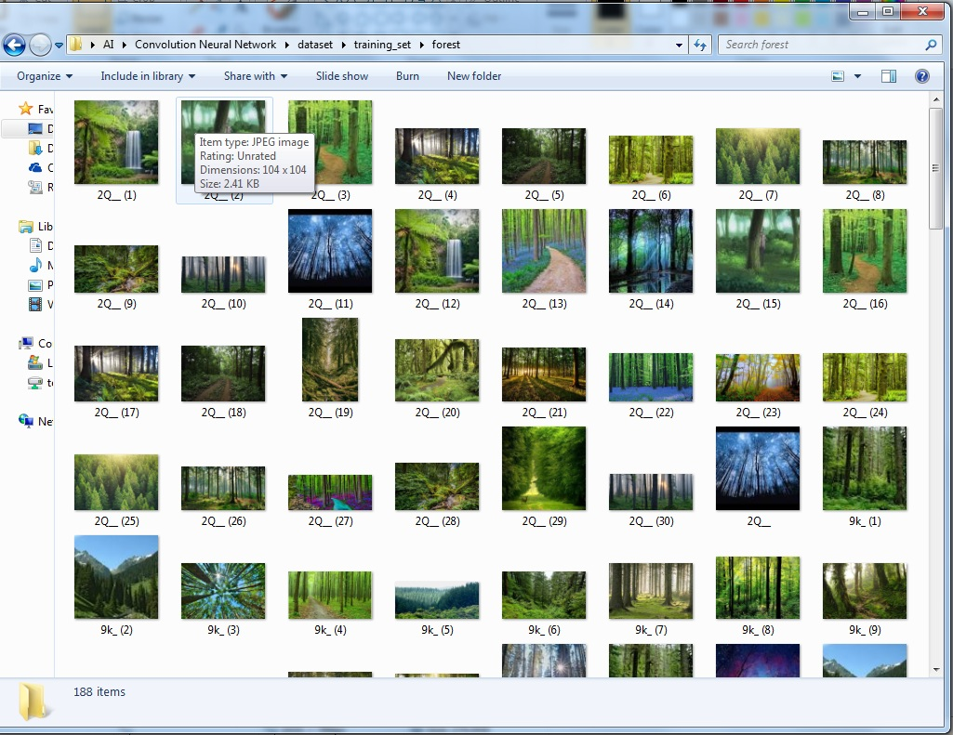
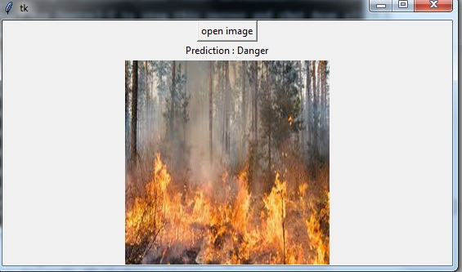
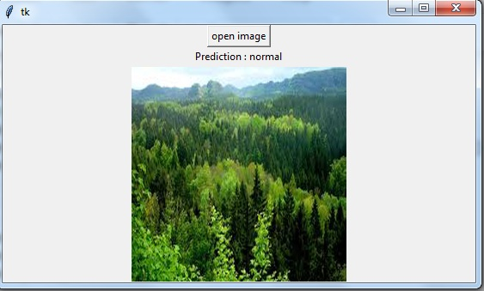
Data Modeling

Slide 9
CONCLUSION
The drastic environment change urges the need of devising new methodology for agriculture i.e. forest fire crop plantation. In this paper, we proposed a new mobile app based on ML algorithms for defining forest identification and classification in forest fire crops. The deep CNN is used for denoising images classification is used for Forest fire classification. The work major concentrates on Forest fire. In the selected 500 images, denoised images are trained with the deep CNN a classifier and their features are taken for pattern matching; remaining 200 images are used for testing.

